Slide 1
Kubernetes Workshop

Slide 2
What does Kubernetes mean
Kubernetes originates from Greek, meaning helmsman or pilot

Slide 3
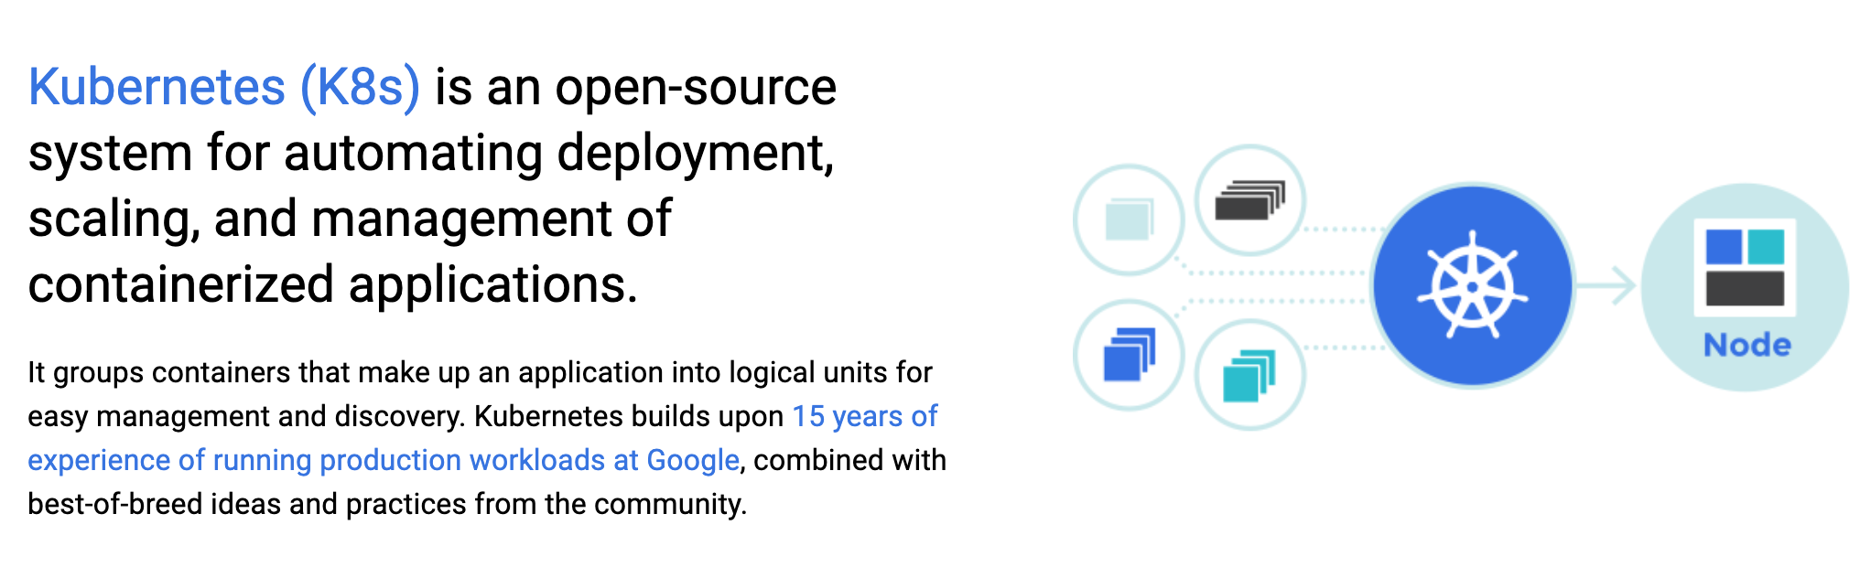
What is Kubernetes?
According to: https://kubernetes.io
Production-Grade Container Orchestration

Slide 4
What is Kubernetes? cont.
A Production-Grade Container Orchestration System
Based on Borg and Omega, which are systems that run inside of Google right now and are proven to work at Google for over 10 years
Google spawns billions of containers per week with these systems
Created by three Google employees initially during the summer of 2014
Grew exponentially and became the first project to get donated to the CNCF
First production-grade version v1.0.1 in July 2015
New minor versions every three months since v1.2.0 in March 2016
Further Reading:
Lessons learned from three container-management systems over a decade
https://queue.acm.org/detail.cfm?id=2898444

Slide 5
Kubernetes is THE Platform for Containerized Workloads
~100
Distributions and platforms
~2200 (1800)
Contributors
~42k
(48k)
Contributions

Slide 6
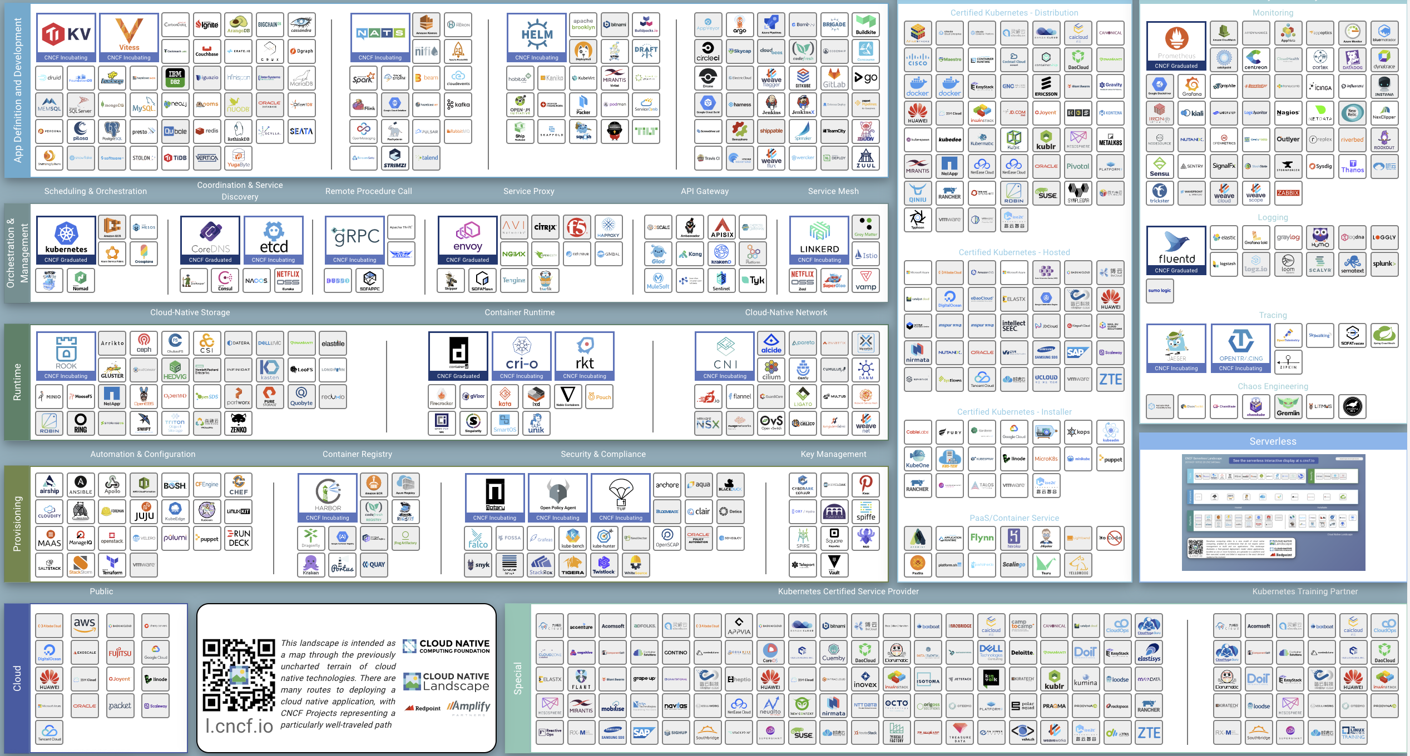
CNCF Landscape

Slide 7
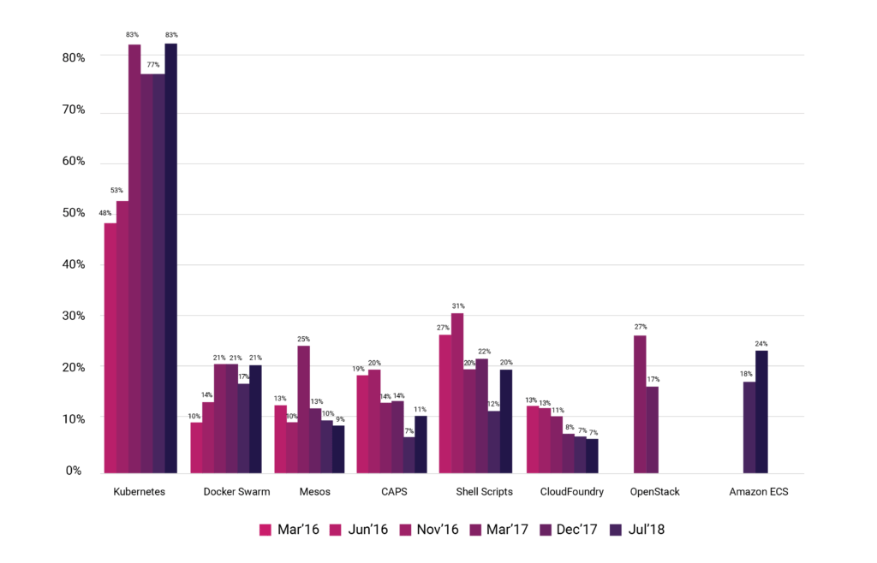
CNCF Survey: Your company/organization manages containers with?

Slide 8
Monitoring Kubernetes with Dynatrace OneAgent

Slide 9
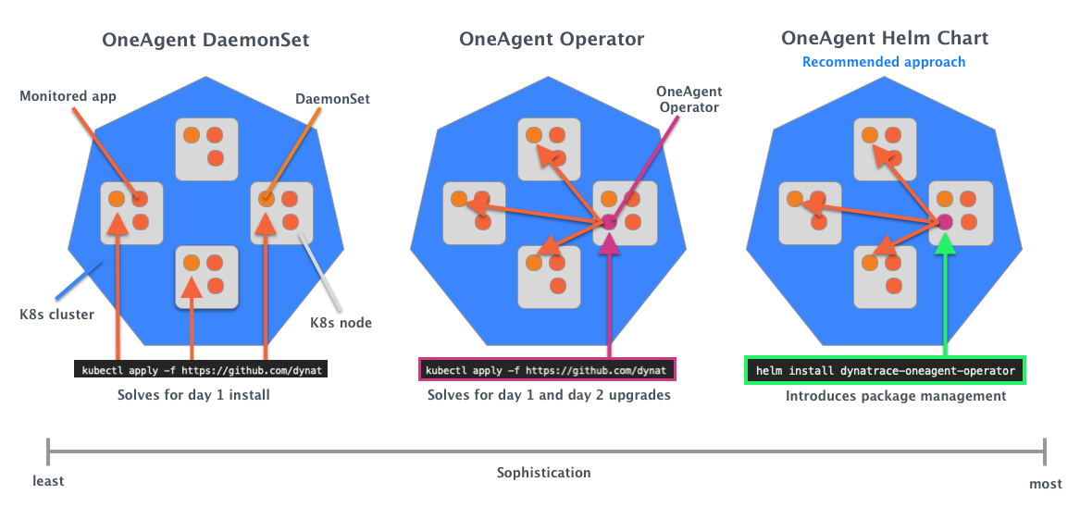
Dynatrace OneAgent Deployment Approaches

Slide 10
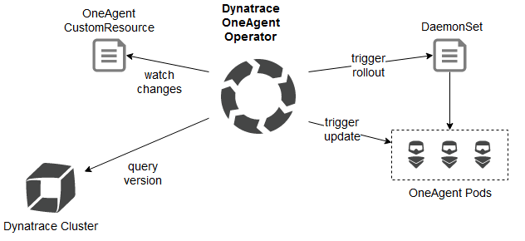
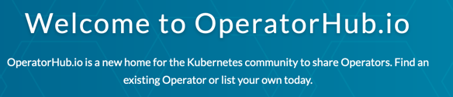
Dynatrace OneAgent Operator
Dynatrace was among the first Red Hat and CoreOS partners to pick up and integrate the Operator SDK into its product.
Built on the open-source Operator SDK
Same full stack visibility as a daemonset deployment
Automatically deploys the OneAgent to all nodes
Adheres to taints & tolerances
Automatically manages lifecycle of the Dynatrace OneAgent
Available on Operator Hub
https://operatorhub.io/operator/dynatrace-monitoring

Slide 11
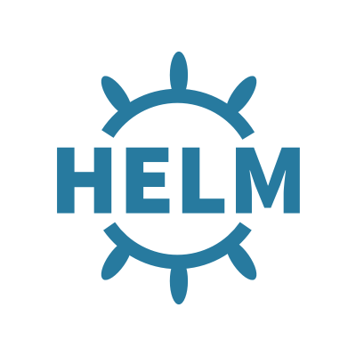
Dynatrace OneAgent Helm Chart
Helm is a package manager for Kubernetes for streamlining and managing Kubernetes applications
Helm chart supports the rollout and lifecycle of Dynatrace OneAgent with parameter-based package management with helm CLI
Allow Dynatrace to be available on GCP Marketplace for GKE
Available on Helm Hub
https://hub.helm.sh/charts/dynatrace/dynatrace-oneagent-operator

Slide 12
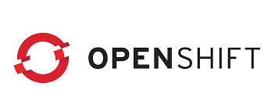
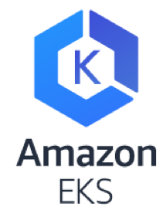
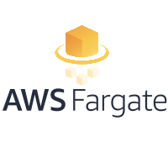
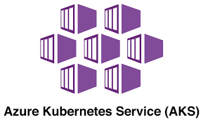
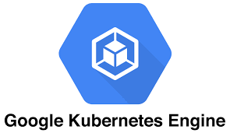
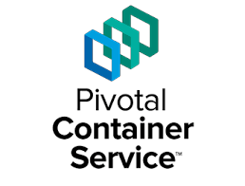
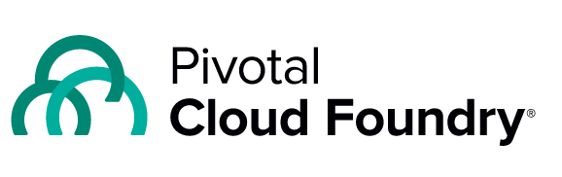
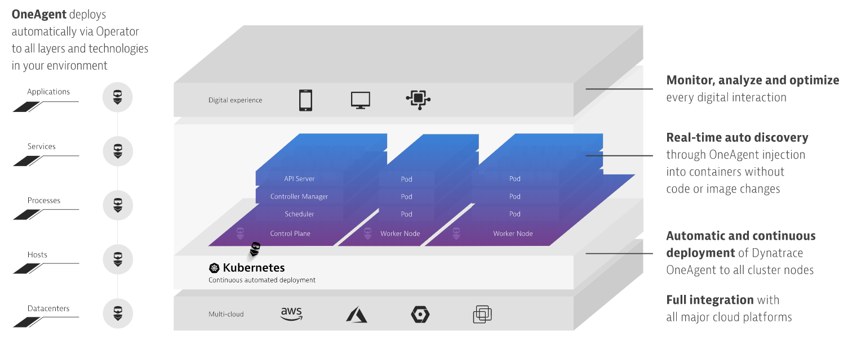
All-in-one, AI-powered monitoring of Kubernetes Applications and Infrastructure via Kubernetes Operator / Helm
Achieving, seeing, sharing success!

